Slide 1
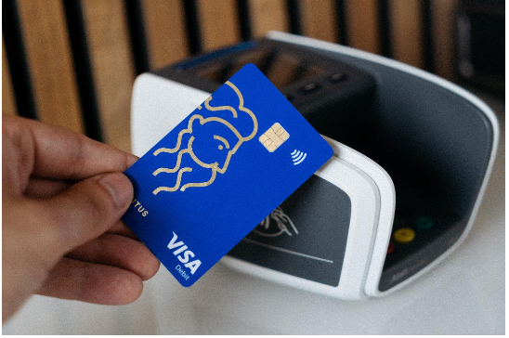

Credit Card Customers Churn Analysis
Data Bootcamp Final Project Presentation

Slide 2
About Me
Name – Adebola Oshinibosi
1st degree – Mathematics and statistics
2nd degree – Financial Management
I have experience in the Financial and Energy sector
I love working with figures and passionate about obtaining information from raw data to solve business problems.

Slide 3




Scope of Analysis
The data source is from Kaggle website
https://www.kaggle.com/datasets/sakshigoyal7/credit-card-customers
The data consists of 21 attributes and 10127 dataset
This dataset consists of Credit card customers including their age, salary, Marital status, credit card limit, credit card category etc
Data Analysed using Excel, SQL , Python and Powerbi

Slide 4
My Project - Objectives
To understand how churn look across the different demographics.
To explore the trend of customers leaving their Credit Card Services.
To identify and predict which type of customer that the banks should target to improve their relationship with them.

Slide 5
Findings
Based on Demography, we can see that more female, middle and highly educated customers tend to churn from their credit card services.
Churn customers tend to have low average utilization ratio, total revolving balance, total transaction count and total transaction amount
Customers with platinum card type are more likely to churn than other card types.

Slide 6
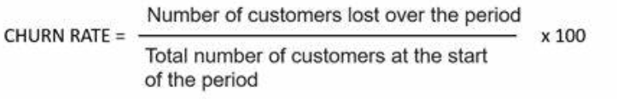
Introduction to Churn
Churn which is also called Attrition, is the rate at which customers stop doing business with an organisation
Reducing Churn is a priority for many companies as keeping customers is easier than getting new customers

Slide 7
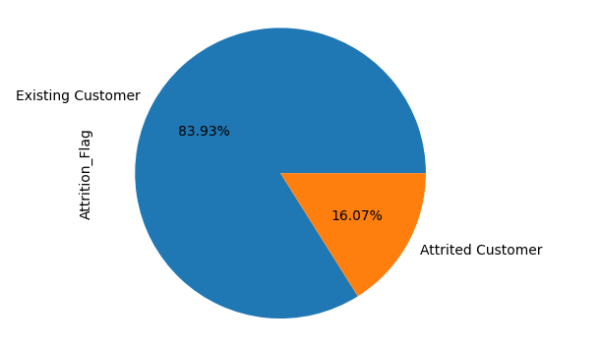
Exploratory data Analysis
Churn rate = 16.07%
16.07% of customers are leaving the bank or leaving their credit card services
Sum of total customer | Sum of Attrition count | Sum of Churn rate | Sum of Existing customer | Sum of Retention rate
10127 | 1627 | 16.07% | 8500 | 83.93%

Slide 8
Churn Analysis by Gender and Card Type

Slide 9
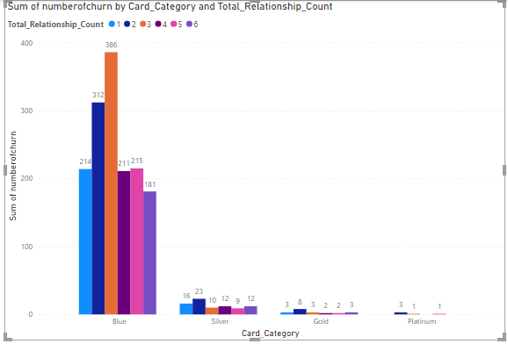
Analysing Card category and total relationship count Customers with low relationship count have a higher number of churn (Total_Relationship_Count = Total no. of products held by the customer)

Slide 10
Churn rate by contact count in 12 month
As the number of contacts increases, the churn rate also tends to increase.
High contact count with customers may be due to dissatisfaction which then lead to churn

Slide 11
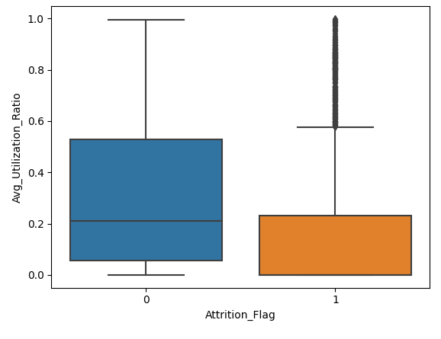
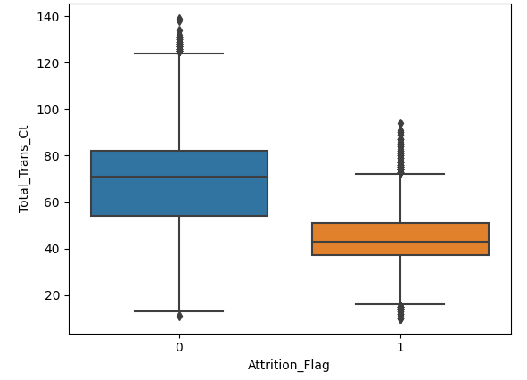
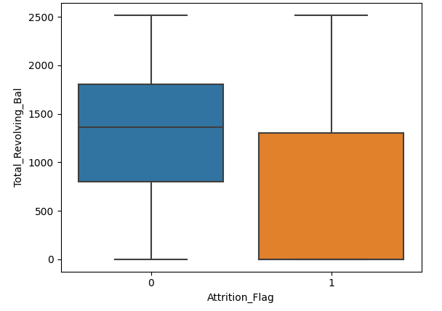
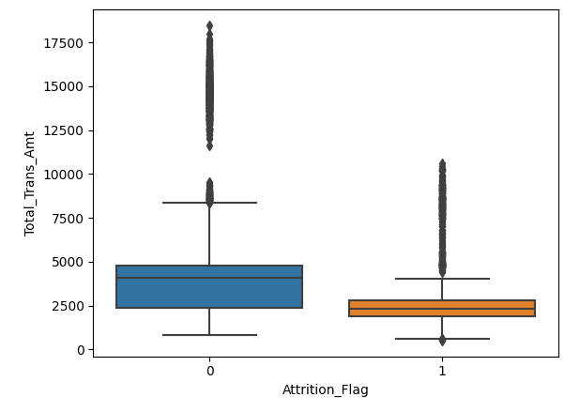

Churn Analysis based on Card Transactions Attributes The Churned customers has a low total transaction count, total transactions amount, total revolving balance, average utilization ratio and total transactions amount compared to the existing customers class, as expected.

Slide 12
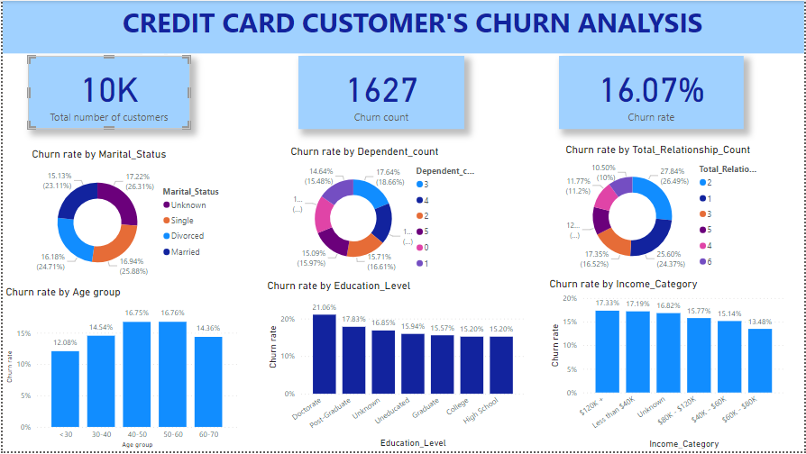

Slide 13
Insights
Based on Demography, we can see that more female customers, middle aged customers and highly educated customers tend to churn
Churn customers tend to have lower total revolving balance, total transaction count, total transaction amount and average utilization ratio
Churn customers tend to have low number of products and high contacts count.
Customers with $120K+ income slightly tend to churn, while customers with $60k — $80K income slightly tend to not churn.
Customers with platinum card type more likely to churn than other card types.

Slide 14
Recommendations
The Bank need to target the customers which are likely to churn by offering special packages like cash back, retirement packages for the middle age customers.
The bank can encourage customers to sign up for additional product as we identified that customers with more products tends not to churn.
We have identified that the average utilization of churned customer are low, they can be offered deals or incentives to make them stick with the bank.
The Bank should focus more on rendering excellent service to reduce churn rate as we identified that the increase in the contact count could be due to dissatisfaction.

Slide 15
Challenges
Utilising all the tools in one project.
The data is imbalanced for example the platinum card has the highest churn ratio but data is too small to explore further.

Slide 16
Conclusion and key learnings
I have learnt a lot throughout the bootcamp and have gain so much confidence in using the tools such as SQL
I appreciate the opportunity given to me by Niyo. Niyo has given me the foundation to launch my career in Data. I feel so empowered.
Github and Linkedin account
https://github.com/Bola-Oshinibosi/Dataproject
https://www.linkedin.com/in/bola-oshinibosi/

